Slide 1
AWS Architecture
Techie Horizon - Day 41 - Task 21
07/ Aug/ 2026
Devops engineer POV(e-Commerce Application)

Slide 2
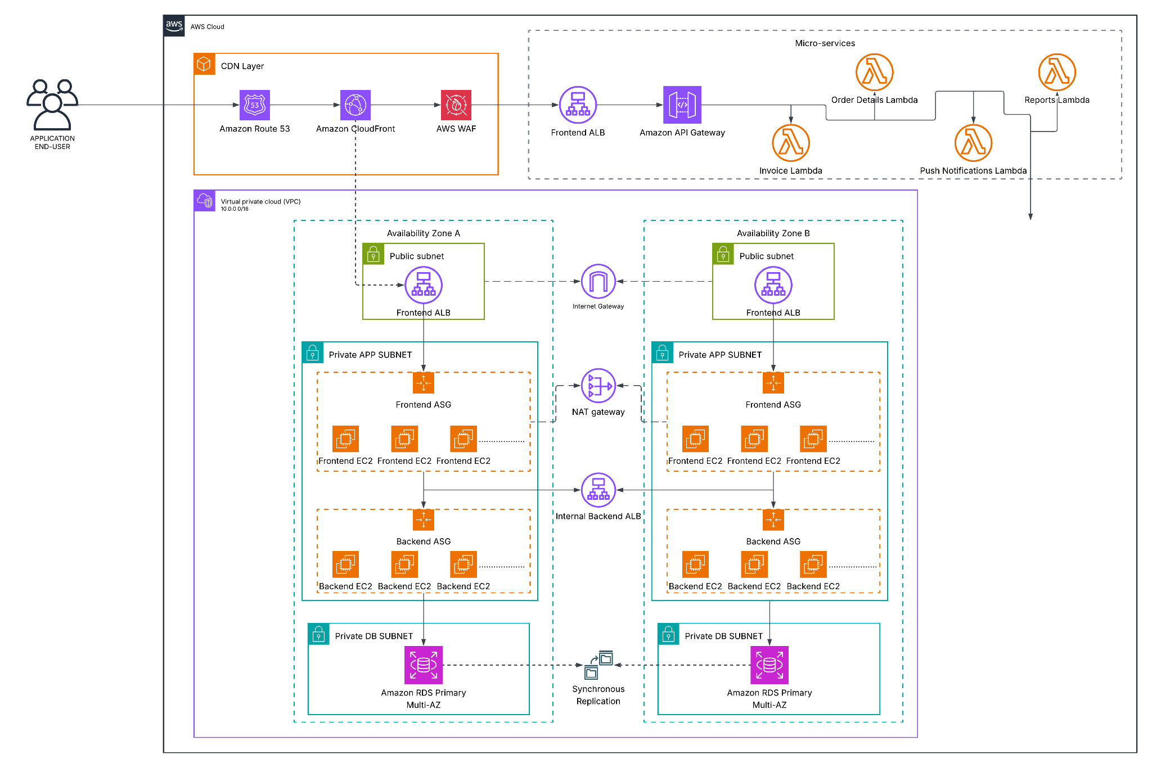

Slide 3
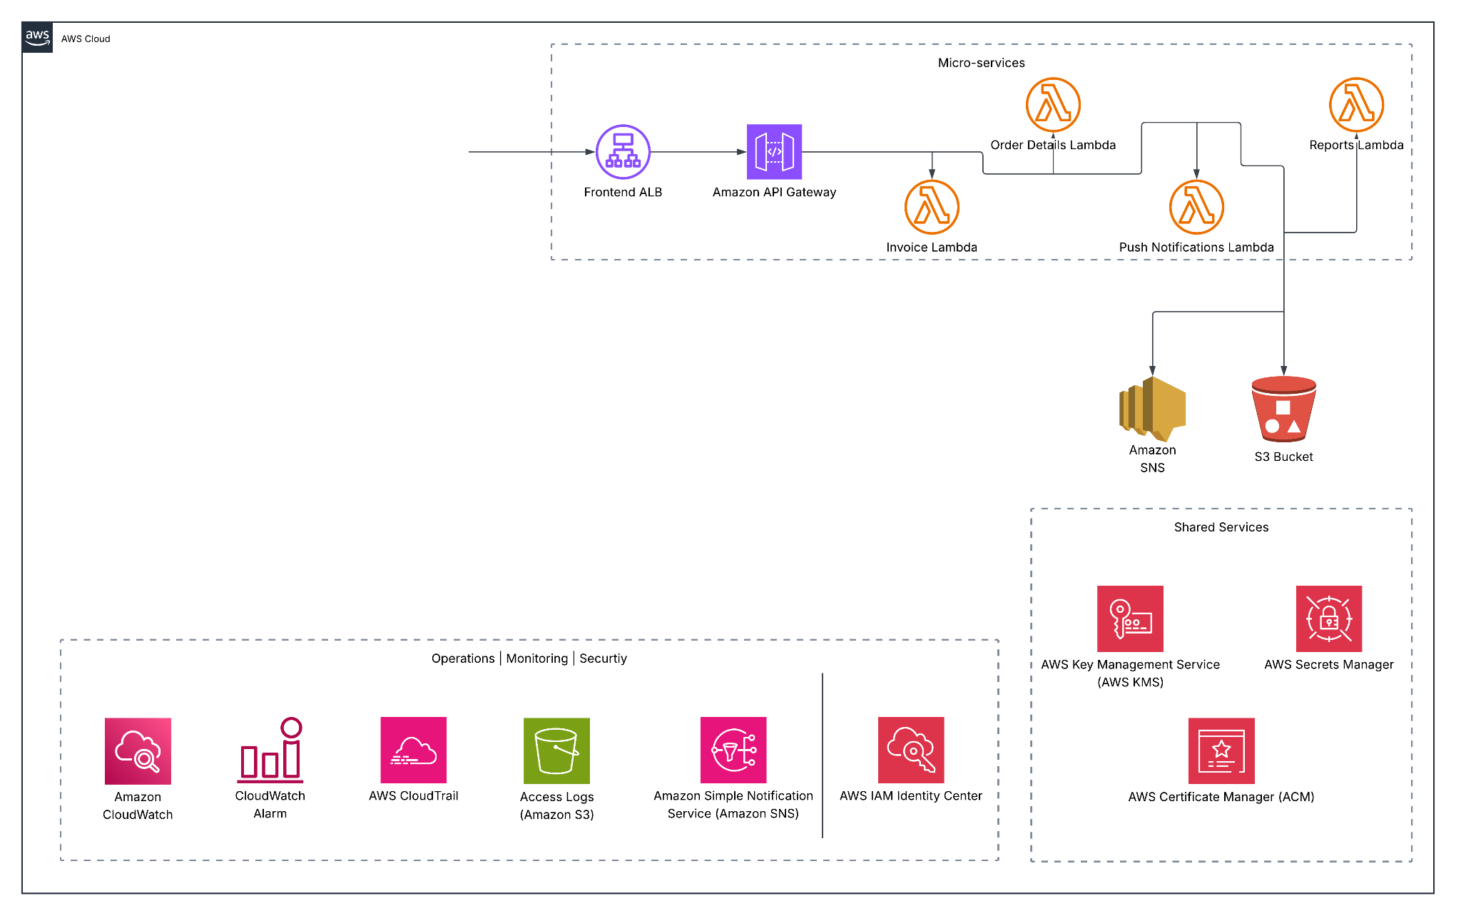

Slide 4
Any questions?
Ask away!
Let's discuss any doubts or concerns.

Slide 5
Thank you

